Slide 1
Probabilistic Models
David Kauchak
CS451 – Fall 2013

Slide 2
Admin
Assignment 6
Assignment 7
CS Lunch on Thursday

Slide 3
Midterm
Midterm
mean: 37
median: 38

Slide 4
Probabilistic Modeling
Model the data with a probabilistic model
specifically, learn p(features, label)
p(features, label) tells us how likely these features and this example are
train
probabilistic model
training data

Slide 5
Basic steps for probabilistic modeling
Probabilistic models
Step 1: pick a model
Step 2: figure out how to estimate the probabilities for the model
Step 3 (optional): deal with overfitting
Which model do we use, i.e. how do we calculate p(feature, label)?
How do train the model, i.e. how to we we estimate the probabilities for the model?
How do we deal with overfitting?

Slide 6
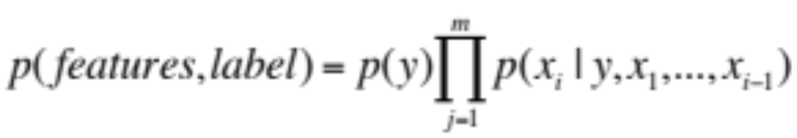
Step 1: pick a model
So, far we have made NO assumptions about the data
Model selection involves making assumptions about the data
We did this before, e.g. assume the data is linearly separable
These assumptions allow us to represent the data more compactly and to estimate the parameters of the model

Slide 7
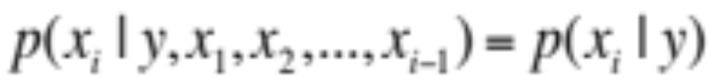
Naïve Bayes assumption
Assumes feature i is independent of the the other features given the label

Slide 8
Basic steps for probabilistic modeling
Probabilistic models
Step 1: pick a model
Step 2: figure out how to estimate the probabilities for the model
Step 3 (optional): deal with overfitting
Which model do we use, i.e. how do we calculate p(feature, label)?
How do train the model, i.e. how to we we estimate the probabilities for the model?
How do we deal with overfitting?

Slide 9


Obtaining probabilities
H
H
T
T
H
T
H
H
T
T
We’ve talked a lot about probabilities, but not where they come from
  How do we calculate p(x_{i}|y) from training data?
  What is the probability of surviving the titanic?
  What is that any review is about Pinot Noir?
  What is the probability that a particular review is about Pinot Noir?

Slide 10
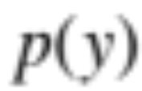
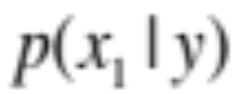
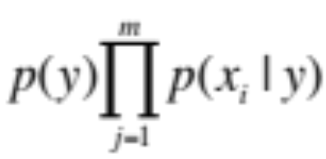
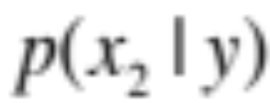
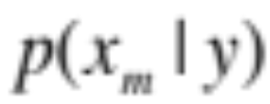
NB: obtaining probabilities
train
probabilistic model
training data
…

Slide 11
Maximum Likelihood Estimation (MLE)
You flip a coin 100 times. 60 times you get heads and 40 times you get tails.
What is the probability for heads?
p(head) = 0.60
Why?

Slide 12
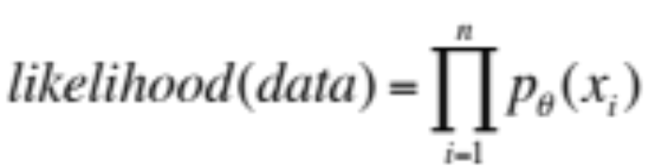
Likelihood
The likelihood of a data set is the probability that a particular model (i.e. a model and estimated probabilities) assigns to the data
for each example
how probable is it under the model
the model parameters (e.g. probability of heads)

Slide 13
Likelihood
You flip a coin 100 times. 60 times you get heads and 40 times you get tails.
What is the likelihood of this data with Θ=p(head) = 0.6 ?
for each example
how probable is it under the model
the model parameters (e.g. probability of heads)

Slide 14
Likelihood
You flip a coin 100 times. 60 times you get heads and 40 times you get tails.
What is the likelihood of this data with Θ=p(head) = 0.6 ?
0.60⁶⁰ * 0.40⁴⁰ ⁼ 5.908465121038621e-30
60 heads with p(head) = 0.6
40 tails with p(tail) = 0.4

Slide 15
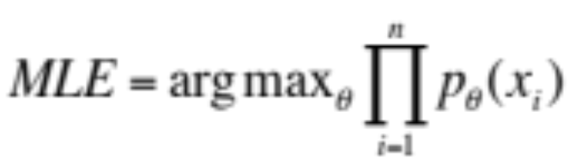
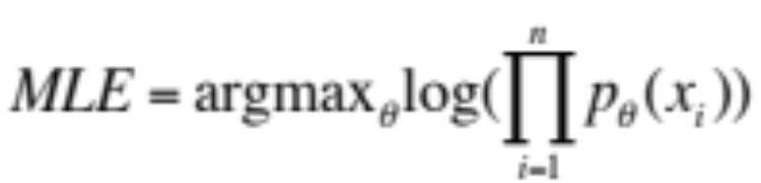
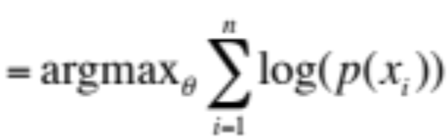
Maximum Likelihood Estimation (MLE)
The maximum likelihood estimate for a model parameter is the one that maximize the likelihood of the training data
Often easier to work with log-likelihood:
Why is this ok?
Notes:
log is a strictly increasing function
it just squishes values but does not change their order, so the max of likelihood is still the max of log-likelihood

Slide 16
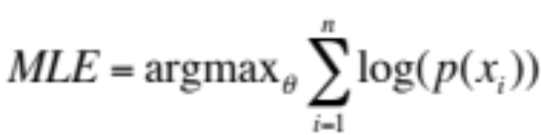
Calculating MLE
The maximum likelihood estimate for a model parameter is the one that maximize the likelihood of the training data
Given some training data, how do we calculate the MLE?
You flip a coin 100 times. 60 times you get heads and 40 times you get tails.

Slide 17
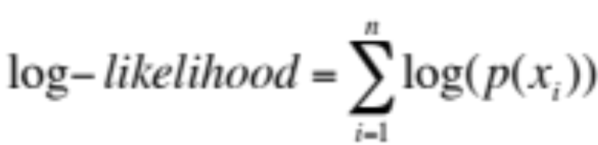

Calculating MLE
You flip a coin 100 times. 60 times you get heads and 40 times you get tails.
How do we find the max?

Slide 18
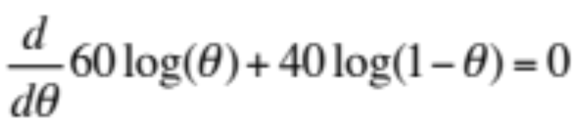
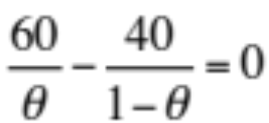
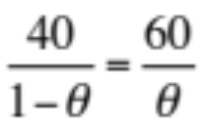


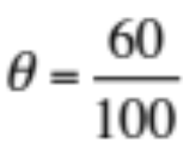
Calculating MLE
You flip a coin 100 times. 60 times you get heads and 40 times you get tails.
Yay!

Slide 19
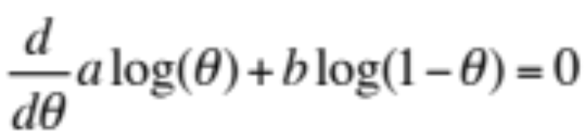
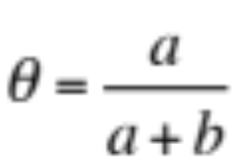
Calculating MLE
You flip a coin n times. a times you get heads and b times you get tails.
…

Slide 20
MLE: sanity check
p(heads) = 0.5
  log(0.50⁶⁰ * 0.50⁴⁰) =-69.3
p(heads) = 0.7
  log(0.70⁶⁰ * 0.30⁴⁰)=-69.5
You flip a coin 100 times. 60 times you get heads and 40 times you get tails.
Can we do any better?
p(heads) = 0.6
log(0.60⁶⁰ * 0.40⁴⁰) = -67.3

Slide 21
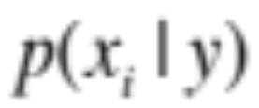
MLE estimation for NB
train
probabilistic model
training data
What are the MLE estimates for these?

Slide 22
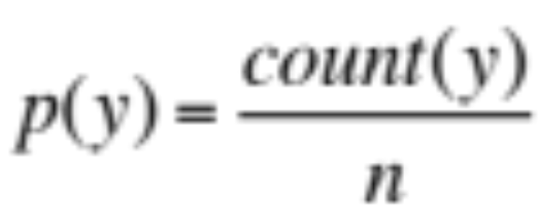
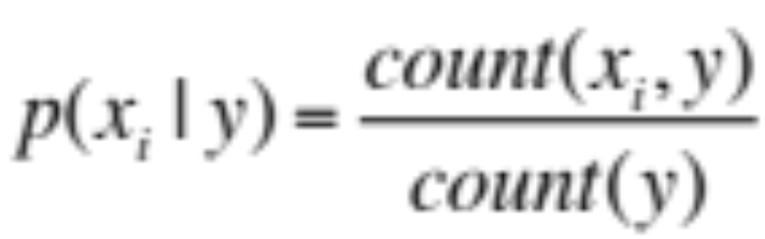
Maximum likelihood estimates
number of examples with label
total number of examples
number of examples with the label with feature
number of examples with label
What does training a NB model then involve?
How difficult is this to calculate?
Notes:
just involves iterating over the data and aggregating these counts!

Slide 23
Naïve Bayes classification
NB Model
p(features, label)
yellow, curved, no leaf, 6oz, banana
0.004
Given an unlabeled example:
yellow, curved, no leaf, 6oz
predict the label
How do we use a probabilistic model for classification/prediction?

Slide 24
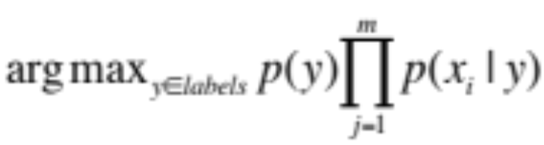
Probabilistic models
yellow, curved, no leaf, 6oz, banana
probabilistic model:
p(features, label)
pick largest
yellow, curved, no leaf, 6oz, apple
label =

Slide 25

Generative Story
To classify with a model, we’re given an example and we obtain the probability
We can also ask how a given model would generate a document
This is the “generative story” for a model
Looking at the generative story can help understand the model
We also can use generative stories to help develop a model
Notes:
- although we don’t generally “generate” a document from a model, it’s often useful to look at the generative story of a model (i.e. how the model says a document was generate) to help us understand why the model assigns certain probabilities

Slide 26
NB generative story
What is the generative story for the NB model?

Slide 27
NB generative story
Pick a label according to p(y)
  roll a biased, num_labels-sided die
For each feature:
  Flip a biased coin:
    if heads, include the feature
    if tails, don’t include the feature
What about for modeling wine reviews?

Slide 28
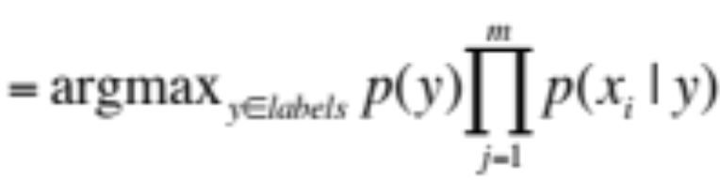
NB decision boundary
label
What does the decision boundary for NB look like if the features are binary?

Slide 29
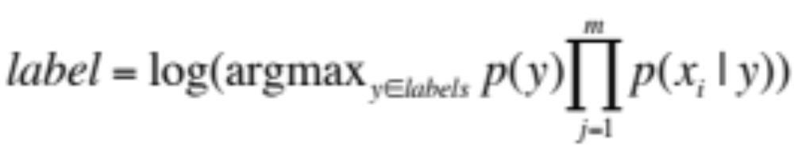
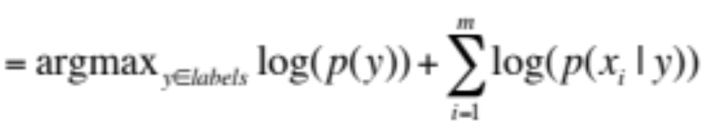
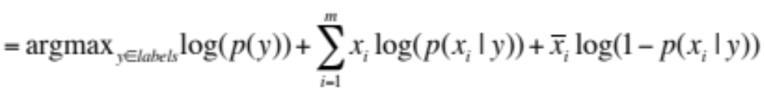
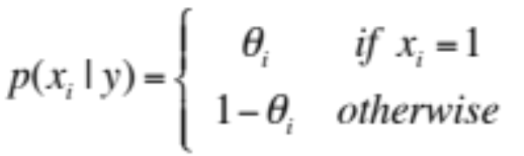
Some maths

Slide 30
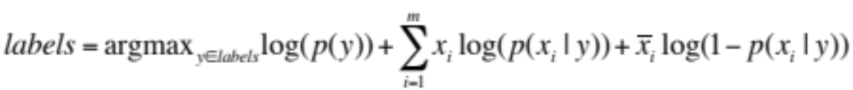
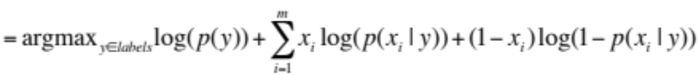
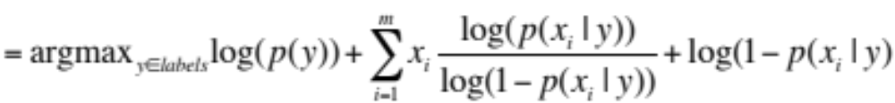
Some more maths
(because x_{i} are binary)

Slide 31
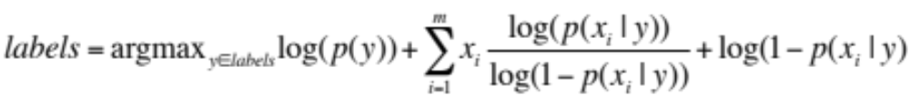
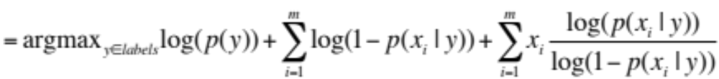
And…
What does this look like?

Slide 32
And…
b
+
x_{i} * w_{i}
w x + b
What are the weights?
Linear model !!!

Slide 33
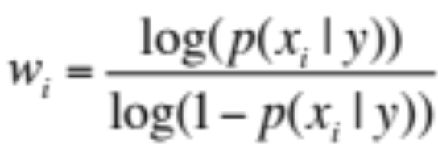
NB as a linear model
How likely this feature is to be 1 given the label
How likely this feature is to be 0 given the label
low weights indicate there isn’t much difference
larger weights (positive or negative) indicate feature is important

Slide 34
Maximum likelihood estimation
Intuitive
Sets the probabilities so as to maximize the probability of the training data
Problems?
  Overfitting!
  Amount of data
    particularly problematic for rare events
  Is our training data representative

Slide 35
Basic steps for probabilistic modeling
Probabilistic models
Step 1: pick a model
Step 2: figure out how to estimate the probabilities for the model
Step 3 (optional): deal with overfitting
Which model do we use, i.e. how do we calculate p(feature, label)?
How do train the model, i.e. how to we we estimate the probabilities for the model?
How do we deal with overfitting?

Slide 36
Coin experiment

Slide 37
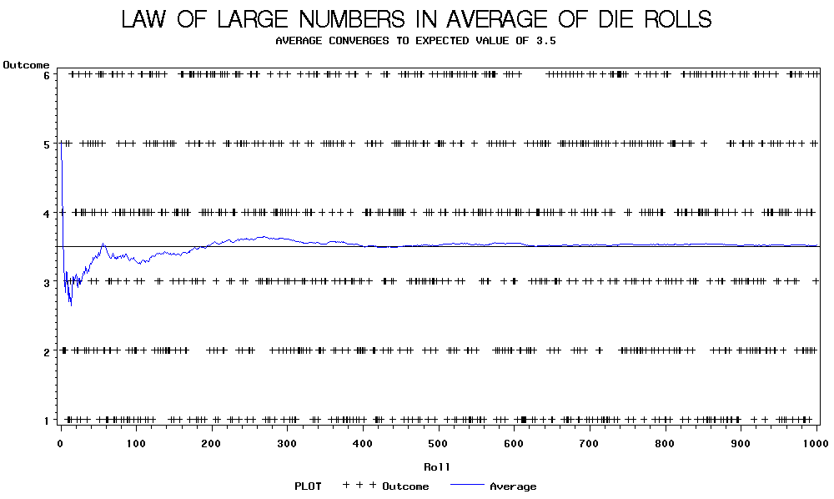

Slide 38
Back to parasitic gaps
Say the actual probability is 1/100,000
We don’t know this, though, so we’re estimating it from a small data set of 10K sentences
What is the probability that we have a parasitic gap sentence in our sample?

Slide 39
Back to parasitic gaps
p(not_parasitic) = 0.99999
p(not_parasitic)¹⁰⁰⁰⁰ ≈ 0.905 is the probability of us NOT finding one
So, probability of us finding one is ~10%, in which case we would incorrectly assume that the probability is 1/10,000 (10 times too large)
Solutions?

Slide 40
Priors
Coin1 data: 3 Heads and 1 Tail
Coin2 data: 30 Heads and 10 tails
Coin3 data: 2 Tails
Coin4 data: 497 Heads and 503 tails
If someone asked you what the probability of heads was for each of these coins, what would you say?

